Slide 1


SOCIAL MEDIA ANALYSIS
BY: Varshith Anishetty

Slide 2
AGENDA
Problem Statement
Data Overview
Database Schema
Key Metrics & Insights
Marketing Strategies
Conclusion

Slide 3

PROBLEM STATEMENT
You are hired as a data analyst at Meta and asked to collaborate with Marketing team. Marketing teams wants to leverage Instagram's user data to develop targeted marketing strategies that will increase user engagement, retention, and acquisition. Provide insights and recommendations to address the following objectives

Slide 4
DATA DESCRIPTION The dataset contains information about 7 tables.
Users : registered user data
Photos : uploaded content
Comments: user interactions
Likes : engagement actions
Follows : network relationships
Tags : content categories
Photo_Tags : tag mapping

Slide 5
KEY FIELDS
comments_id : unique identifier for each comment
comment_text : text content of a given comment
user_id : unique identifier for each user
photo_id : unique identifier for each photo
created_at : date of interaction in the form of likes, photos, and tags
follower_id : user_id of the follower for a certain user
followee_id : user_id of followee for a certain user
tag_id : unique identifier for each tag
image_url : link to the image posted on the platform
username : username chosen by the user

Slide 6
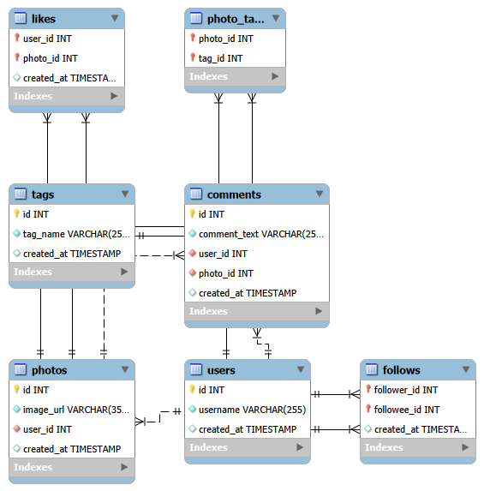
DATABASE SCHEMA

Slide 7
User Activity Distribution
74% of users are active, indicating strong overall platform participation.
26% of users are inactive, representing a significant retention gap.
A quarter of the user base is not contributing to engagement or content creation.
Reactivating even a portion of inactive users could significantly boost platform interaction levels.
Inactivity represents the largest immediate opportunity for engagement growth.

Slide 8
Engagement Concentration
Engagement is highly concentrated among a small group of users.
Top 10 users generate over 200 interactions each.
Highest performer reaches 405 total engagements.
A small percentage of creators drive majority platform interaction.
Platform engagement follows a power-law distribution driven by top creators.

Slide 9
Hashtag & Content Insight
Engagement is strongly driven by lifestyle and emotion-based hashtags.
Engagement is strongly driven by lifestyle and emotion-based hashtags.
“Smile” generates the highest engagement (1802 interactions).
Content themes significantly influence interaction levels.
Emotion-driven and lifestyle-focused content drives the highest engagement.

Slide 10
Upload vs Engagement Correlation
Engagement increases consistently with posting frequency.
Users with 1–2 posts average below 110 interactions.
Users with 5+ posts exceed 200 average engagements.
Consistency significantly amplifies audience interaction.
Sustained content creation directly drives higher engagement levels.

Slide 11
Cohort Analysis (Joining Year Insight)
Users who joined in 2016 generate an average of 51.43 engagements per post, slightly outperforming the 2017 cohort in engagement efficiency.
Users who joined in 2016 generate an average of 51.43 engagements per post, slightly outperforming the 2017 cohort in engagement efficiency.
The small difference between cohorts suggests that engagement behavior remains consistent across user generations.
There is no significant engagement gap between early and newer adopters, indicating stable platform experience over time.
Engagement efficiency remains stable across cohorts, reflecting consistent user interaction quality.

Slide 12
User Segmentation Model
The majority of users (53%) fall under the Emerging category, representing the largest growth opportunity on the platform.
19% of users are High-Value Creators who consistently generate strong engagement and drive interaction.
26% of users are completely inactive, indicating a significant retention challenge.
Only 2% are active but low-performing, suggesting most active users maintain reasonable engagement levels.
Emerging users represent the primary leverage point for scaling overall platform engagement.

Slide 13
Influencer & High-Value Creator Identification
These users demonstrate the highest engagement efficiency, averaging above 42 interactions per post.
Engagement per post is a stronger influencer metric than follower count or total posts.
Engagement per post is a stronger influencer metric than follower count or total posts.
High efficiency indicates strong audience responsiveness and content relevance.
Engagement efficiency is a more reliable indicator of influence than raw follower volume.

Slide 14
Strategic Growth Framework
Retention Strategy
Launch targeted re-engagement campaigns for inactive users.
Offer incentives such as feature visibility or gamified rewards.
Use personalized notifications to bring dormant users back.
Growth Strategy
Convert Emerging Users into High-Value Creators.
Encourage consistent posting through content prompts.
Promote high-performing hashtags to amplify reach.
Engagement Optimization
Identify and reward high-efficiency creators.
Prioritize emotion-driven and lifestyle content themes.
Optimize posting consistency to sustain interaction growth.

Slide 15
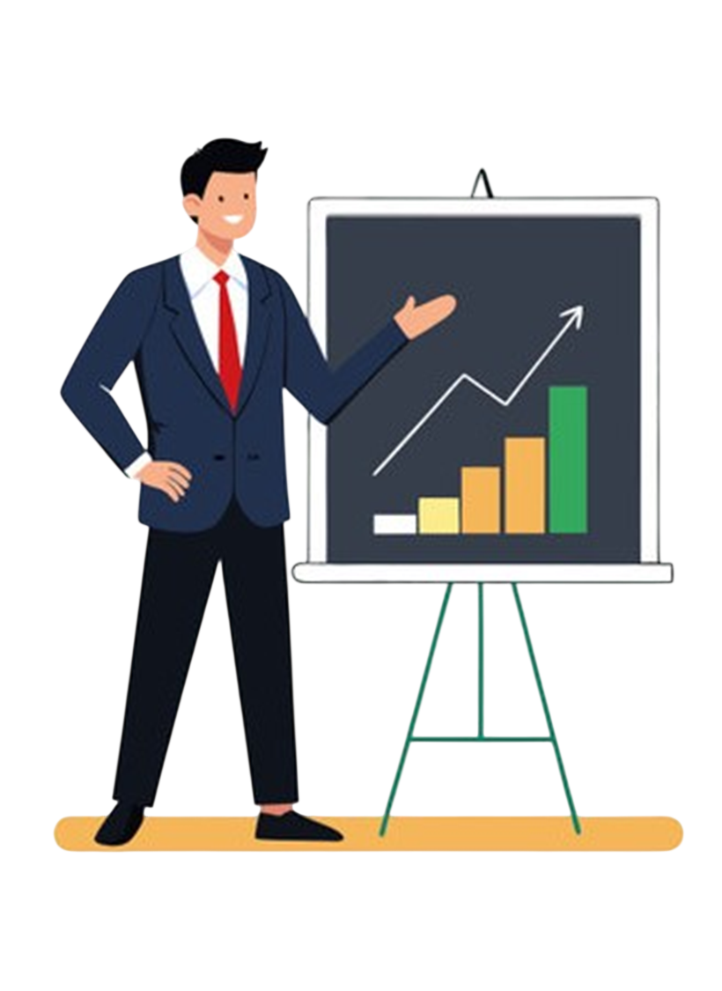
Business Recommendations
Prioritize reactivation of the 26% inactive user segment through targeted engagement campaigns.
Develop structured influencer programs using engagement efficiency as the primary selection metric.
Encourage consistent content creation by promoting high-performing hashtags and content themes.
Invest in Emerging Users, as they represent the largest scalable growth segment (53%).
Implement data-driven performance tracking using engagement per post as a core KPI.
Leverage cohort-based insights to maintain consistent onboarding experience and sustain engagement across new user segments.

Slide 16

Conclusion & Key Takeaways
Engagement on the platform is highly concentrated among a small group of high-value creators.
Posting consistency strongly correlates with higher engagement levels.
Emotion-driven and lifestyle-based content themes generate the highest interaction.
The Emerging User segment represents the largest growth opportunity.
Targeted segmentation enables scalable, data-driven growth strategies.
Data-driven segmentation and creator-focused optimization are key to sustained platform growth.

Slide 17

THANKYOU

